Slide 1

Elements of Electrical and Electronics Engineering (7AC48) UNIT-III: Induction Motors and Instruments
By
Dr. G. Ramesh (Mob:9182516594)
Associate Professor, Dept. of EEE

Slide 2
Unit-III: Syllabus
Concept of Faraday’s Laws
3-Phase Induction Motors Working Principle
Operation and Construction Details
Instrumentation Introduction
Classification of instruments
Operating principles
Essential futures of measuring instruments

Slide 3
Permanent magnet moving coil (PMMC) instruments
Permanent magnet moving iron (MI) instruments
Text BooK: Basic Electrical Engineering by T.K.Nagsarkar and M.S.Sukhja Oxford University Press. 2nd edition

Slide 4
Concept of Faraday's Law
Faraday's law of induction (shortly called Faraday’s law) is a basic law of electromagnetism predicting how a magnetic field will interact with an electric circuit to produce an electromotive force (EMF)—a phenomenon called electromagnetic induction.
Electromagnetic induction is the production of voltage or electromotive force due to a change in the magnetic field.
Electromagnetic induction was discovered by Michael Faraday in the 1830s. Many electrical components and types of equipment work based on the principle of electromagnetic induction.

Slide 5
It is the fundamental operating principle of transformers and induction machines based on faraday’s law of electromagnetic induction.
Electromagnetic induction is the production of an electromotive force across an electrical conductor in a changing magnetic field.
A transformer consists of two electrically isolated coils and operates on Faraday's principal of “mutual induction”, in which an EMF is induced in the transformers secondary coil by the magnetic flux generated by the voltages and currents flowing in the primary coil winding.

Slide 6
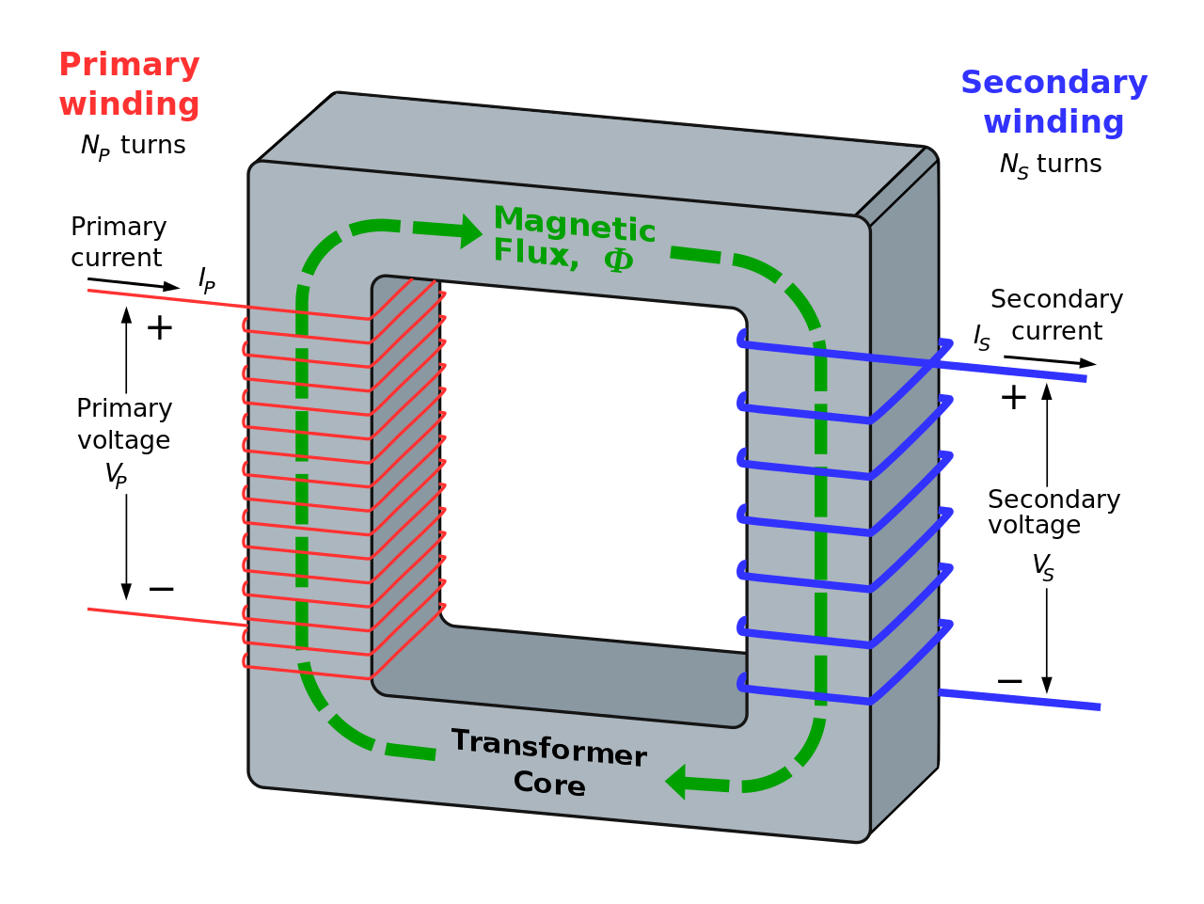
A transformer consists of two electrically isolated coils and operates on Faraday's principal of “mutual induction”, in which an EMF is induced in the transformers secondary coil by the magnetic flux generated by the voltages and currents flowing in the primary coil winding.

Slide 7
A transformer is a static device, which converts electric power from one circuits (coil) to another circuit.
If one coil is connected to a source of alternating voltage, an alternating voltage setup magnetic flux in the laminated core, most of which is linked with the other coil in which it produced mutually induced emf.
If secondary coil closed, a current flows in it and so electrical energy transferred from first coil to second coil.
Induction motor can be treated as a rotating transformer i.e. one in which primary winding is stationary but secondary is free to rotate.

Slide 8
Induction Motors (IM)
An induction motor or asynchronous motor is an AC electric motor in which the electric current in the rotor needed to produce torque is obtained by electromagnetic induction from the magnetic field of the stator winding.
An induction motor can therefore be made without electrical connections to the rotor. IM mainly use to convert electrical energy into mechanical energy.
Applications: pump set, crane, lift, conveyers, fans etc

Slide 9
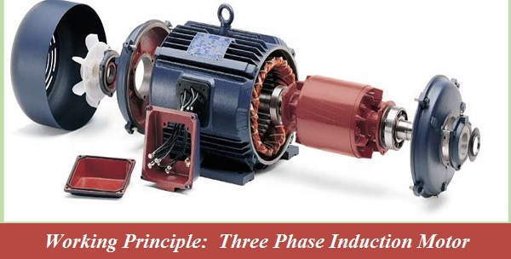
Working Principle of Three phase IM

Slide 10
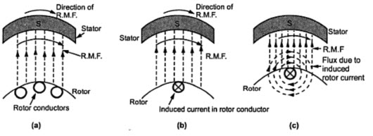
When the motor is excited with three-phase supply, three-phase stator winding produce a rotating magnetic field (RMF) with 120 displacements at constant magnitude which rotates at synchronous speed.

Slide 11
This changing magnetic field (or) RMF cuts the rotor conductors and induces a current in them according to the principle of Faraday’s laws of electromagnetic induction. As these rotor conductors are shorted, the current starts to flow through these conductors.
In the presence of magnetic field of stator, rotor conductors are placed, and therefore, according to the Lorenz force principle, a mechanical force acts on the rotor conductor. Thus, all the rotor conductors force, i.e., the sum of the mechanical forces produces torque in the rotor which tends to move it in the same direction of rotating magnetic field (RMF).

Slide 12
This rotor conductor’s rotation can also be explained by Lenz’s law which tells that the induced currents in the rotor oppose the cause for its production, here this opposition is rotating magnetic field.
This result the rotor starts rotating in the same direction of the stator rotating magnetic field. If the rotor speed more than stator speed, then no current will induce in the rotor because the reason for rotor rotation is the relative speed of the rotor and stator magnetic fields.
This stator and the rotor fields difference is called as slip. This how 3-phase motor is called as asynchronous machine due to this relative speed difference between the stator and the rotors.

Slide 13
As we discussed above, the relative speed between the stator field and the rotor conductors causes to rotate the rotor in a particular direction.
Hence, for producing the rotation, the rotor speed Nr must always be less than the stator field speed Ns, and the difference between these two parameters depends on the load on the motor.
The difference between the synchronous speed (Ns) and rotor speed (Nr) is known as a slip.
Where

Slide 14
Operation and Construction Details
The three phase induction motor is a preferable type of motor.
It is mostly used in industrial drives because it is very reasonable, economical and reliable.
It is also called asynchronous motor because it does not run at a synchronous speed.
The induction motor requires very little maintenance and also it has high overloading capacity.
It has sufficiently high efficiency. In normal running condition, no brushes are needed, hence frictional losses are reduced.

Slide 15
Construction Details
Three phase Induction motor mainly consists of two parts called as the Stator and the Rotor.
The stator is the stationary part of the induction motor, and the rotor is the rotating part.
The construction of the stator is similar to the three-phase synchronous motor, and the construction of rotor is different for the different machine.
STATOR: The stator is built up of high-grade alloy steel laminations to reduce eddy current losses. It has three main parts, namely outer frame, the stator core and a stator winding.

Slide 16
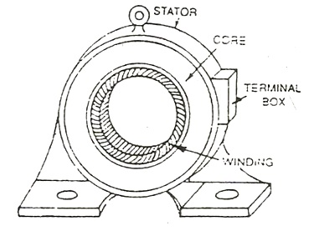
The stator is built up of high-grade alloy steel laminations to reduce eddy current losses. It has three main parts, namely outer frame, the stator core and a stator winding.

Slide 17
ROTOR : The rotor is also built of thin laminations of the same material as the stator. The laminated cylindrical core is mounted directly on the shaft. These laminations are slotted on the outer side to receive the conductors.
There are two types of rotor.
Squirrel-Cage Rotor: Motors employing this type of rotor are known a squirrel-cage induction motor
Slip-Ring Rotor: Motors employing this type of rotor are known a slip-ring induction motor

Slide 18
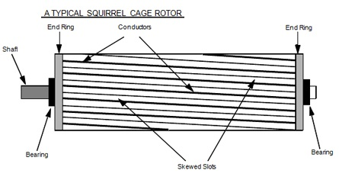
Squirrel-Cage IM Motor: Almost 90 per cent of IM’s are squirrel cage type.
A squirrel cage rotor consists of a laminated cylindrical core. The circular slots at the outer periphery are semi-closed. Each slot contains uninsulated bar conductor of aluminum or copper. At the end of the rotor the conductors the short-circuited by a heavy ring of copper or aluminum.

Slide 19
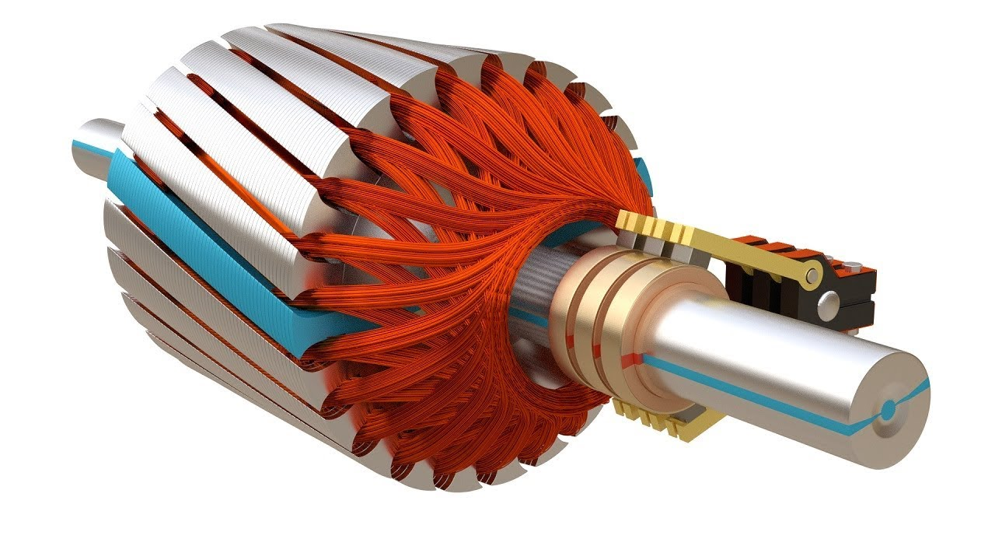
Slip-Ring IM Motor:
It consists of a cylindrical core which is laminated. The outer periphery of the rotor has a semi-closed slot which carries a 3 phase insulated windings. The rotor windings are connected in star. The resistor enables the variation of each rotor phase resistance to increase starting toque, decrease the starting current and used to speed control of the motor.

Slide 20
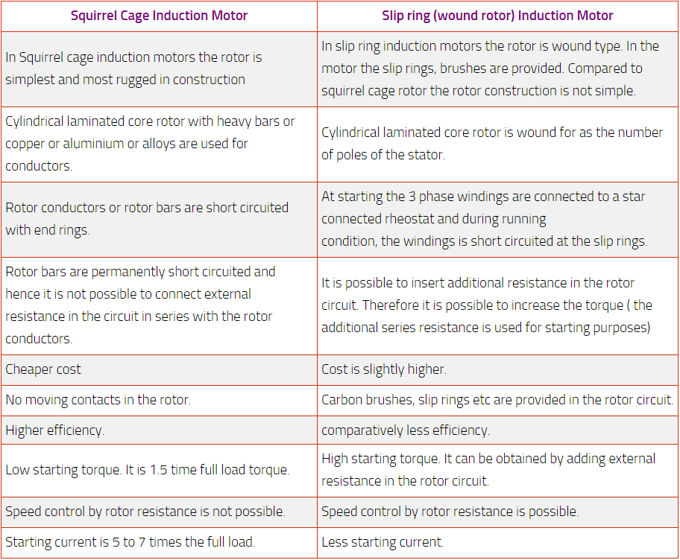

Slide 21
Instrumentation Introduction
An instrument is a device in which we can determine the magnitude or value of the quantity to be measured.
A material measure is a measuring instrument that reproduces one or more known values of a given physical quantity.
Examples of measures are balance weights, measuring resistors, and measuring capacitors.
The measuring quantity in electrical engineering are voltage, current, power and energy.

Slide 22
The fundamental quantities of electrical engineering such as current, voltage, power, energy, frequency etc., have to be measured with the help of instruments for the purpose of computing the system efficiency and stability.
These instruments show the electrical quantity on its scale by a pointer or digital values.
The measurement of any quantity plays very important role not only in science but in all branches of engineering, medicine and in almost all the human day to day activities.

Slide 23
The role of science and engineering is to discover the new phenomena, new relationships, the laws of nature and to apply these discoveries to human as well as other scientific needs.
The science and engineering is also responsible for the design of new equipment's.
The operation, control and the maintenance of such equipment's and the processes is also one of the important functions of the science and engineering branches.
All these activities are based on the proper measurement and recording of physical, chemical, mechanical, optical and many other types of parameters.

Slide 24
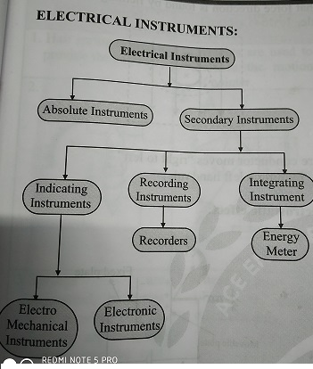
Classification of Instruments
An instrument generally instruments are classified in to two categories

Slide 25
Absolute Instrument
An absolute instrument determines the magnitude of the quantity to be measured in terms of the instrument parameter.
This instrument is really used, because each time the value of the measuring quantities varies. So we have to calculate the magnitude of the measuring quantity, analytically which is time consuming.
These types of instruments are accurate meters and suitable for laboratory use (researching).
Example: Tangent galvanometer, Religh’s current balance and absolute electrometer.

Slide 26
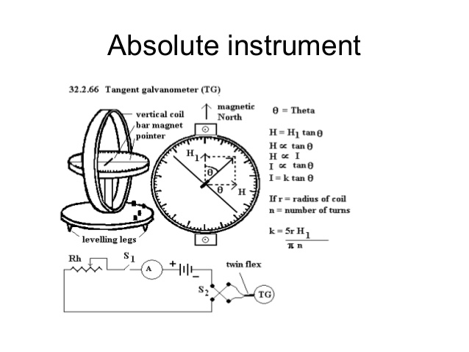

Slide 27
Secondary Instrument
This instrument determines the value of the quantity to be measured directly.
Generally these instruments are calibrated by comparing with another standard secondary instrument.
Examples of such instruments are voltmeter, ammeter and wattmeter etc.
Practically secondary instruments are suitable for measurement, which are classified into three groups: indicating instruments, recording instruments and integrating instruments.

Slide 28
Indicating Instruments
These instruments will give instantaneous values of the quantity to be measured.
This instrument uses a dial and pointer to determine the value of measuring quantity.
The pointer indication gives the magnitude of measuring quantity.
Example: PMMC, MI, Dynamometer wattmeter, frequency meter and power factor meter.

Slide 29
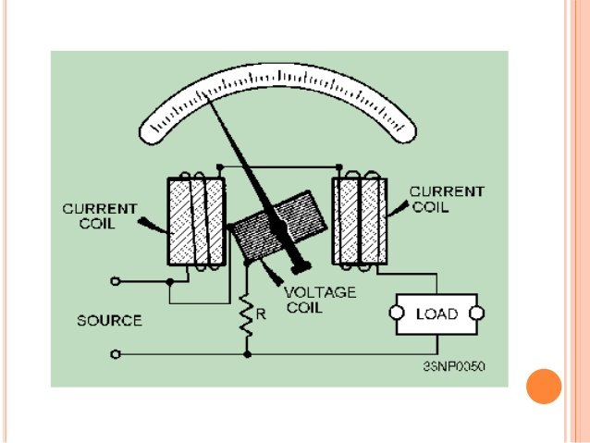

Slide 30
Recording Instruments
This type of instruments records the magnitude of the quantity to be measured continuously over a specified period of time.
Recorded over a graph paper by a light weight pen.
These are used to observe load variation continuously.
Example: Recording voltammeter, Recording wattmeter, ECG and Storage oscilloscope.

Slide 31
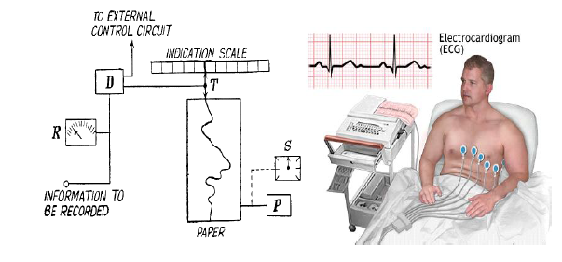

Slide 32
Integrating Instruments
This type of instrument gives the total amount of the quantity to be measured over a specified period of time.
These instruments add the measured value to existing value.
These instruments will give the total electricity consumed over a period of time (one month).
Example: Energy meter or KWhr meter, KVARh meter and Ampere hour (Ah) meter.

Slide 33
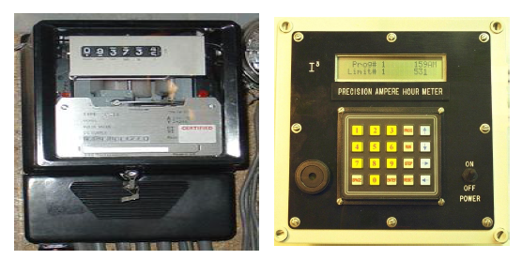
Energy meter

Slide 34
Operating Principle of Indicating Instruments
Most of the electrical instruments are indicating instruments.
Basic operating principle of a measuring instruments are detecting an input signal and producing an output signal .
Instruments usually comprise a sensor, an amplifier, and a display.
The principle of operation of measuring instruments depend upon the various effects of electric current used in their operation. They are classified as in the table shown below.

Slide 35
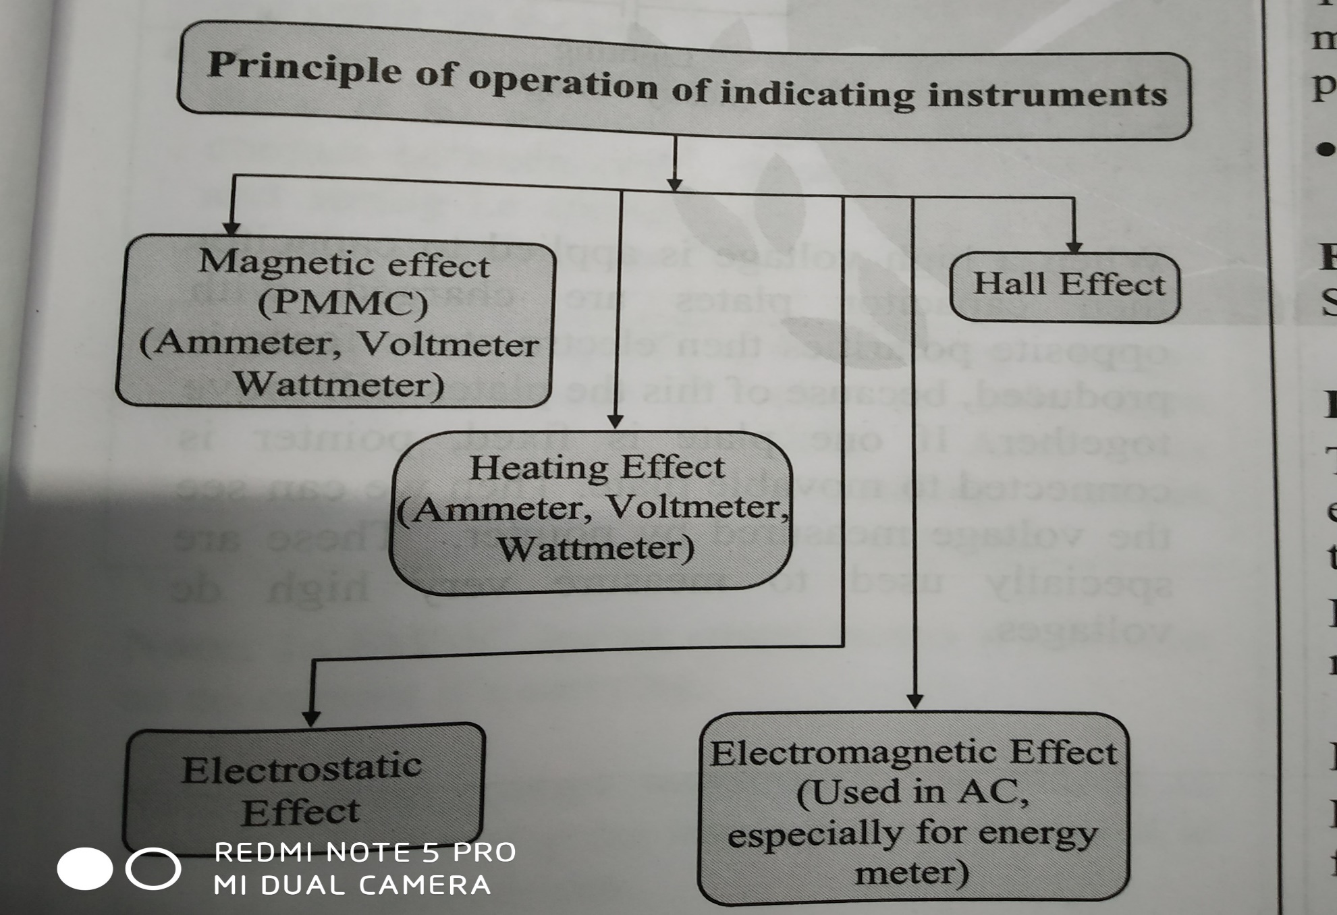

Slide 36
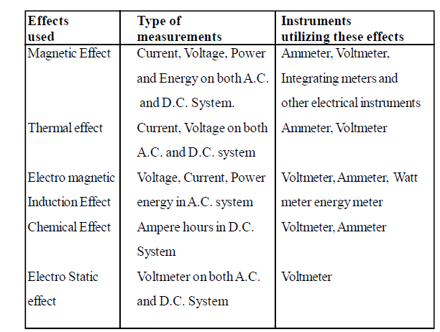

Slide 37
Essential features or requirements of Indicating Instruments
Indicating instruments are those which indicate the value of the quantity under measurement. The essential requirements of indicating instruments are.,
Pointer.
Pre Calibrated Scale.
Deflecting or operating torque.
Controlling or restoring torque.
Damping torque.

Slide 38
Pointer
The shape and size of the pointer normally depends on the type and size of instruments, usually aluminum tube or strip is used as a material for pointer.
The end of the pointer is flattened to the shape of an arrow head and is made to move over a mirror and graduated scale.
The mirror helps in avoiding parallel axis. The arm of the pointer usually has a double bend to adjust the arrowhead in level to the scale.
A small counter weight is attached at the tail end for balancing .

Slide 39
Pre Calibrated Scale
A clearly marked graduated scale is attached to the case over the pointer. The length of the scale depends upon the length of the pointer and the angle to which it can rotate for full scale deflection.
The scale is printed on a stiff cord usually glazed and white background and block making.
There are two types of scales used in indicating instruments, namely uniform scale and non-uniform scale. In uniform scale, each division is equally divided and in non-uniform scale is cramped at ends and broadly divided in middle part of the scale.

Slide 40
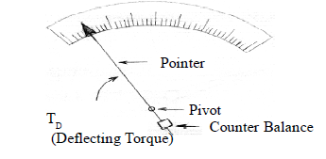
Deflecting or Operating Torque
A torque to move the pointer from its zero position in same proportion to the magnitude of the quantity being measured. This torque is called deflecting torque.

Slide 41
The deflecting torque causes the moving system of the instrument to move from its initial zero position.
The magnitude of the deflecting torque depends upon, the magnitude of the measurable quantity.
The torque is produced by the effects of electric current such as magnetic, electro-magneting, heating, electrostatic etc.
The method of production of deflecting torque and its relation to the measurable quantity depends upon the type of instrument.

Slide 42
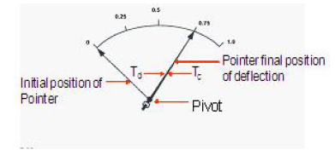
Controlling or Restoring Torque
If the pointer has to stop at a value indicating the magnitude of the quantity, there should be an equal and opposite torque at that instant to keep the pointer in stable position. This torque is called controlling torque.

Slide 43
The force acting on a moving system, in opposite direction to deflecting torque and makes the pointer stable at its final deflected position is called Controlling Torque or Controlling Force.
The pointer will try to rotate as motor in absence of this torque. It also brings the pointer back to zero position, after disconnecting the meter from the circuit.
The controlling torque is provided in the following ways.
Spring control
Gravity control

Slide 44
In spring control torque, a helical hair spring is attached to the moving system in such a way that its one end (inner side) is fixed to the moving system, while the outer end to a rigid body. The stress in the spring exerts, a torque on the moving mechanism opposite to the motion of the moving mechanism. This torque is proportional to the angle of deflection.
In gravity control method, a small weight is attached to the moving system in such a way that it gets activated at the time of deflection and produces a controlling torque in proportion to the deflection. The magnitude of the controlling torque can be varied by adjusting the position of the controlling weight upon the arm.

Slide 45
Damping Torque
In the indicating instruments, the pointer will oscillate about its deflected position before coming to rest due to inertia.
To bring the moving part to rest at the quickest possible time at the deflected position, a force is used which is called damping force.
It operate on the moving system to bring it rest at the quickest possible time. The instrument provided with a damping system is known as dead beat type instrument.

Slide 46
Different devices are used to provide suitable damping. The various methods adopted for damping are.,
a) Air friction damping
b) Fluid friction damping
c) Eddy current damping

Slide 47
Permanent Magnet Moving Coil (PMMC) Instrument
The instruments which use the permanent magnet for creating the stationary magnetic field between which the coil moves is known as the permanent magnet moving coil or PMMC instrument.
It operates on the principle that the torque is exerted on the moving coil placed in the field of the permanent magnet.
The PMMC instrument gives the accurate result for DC measurement.

Slide 48
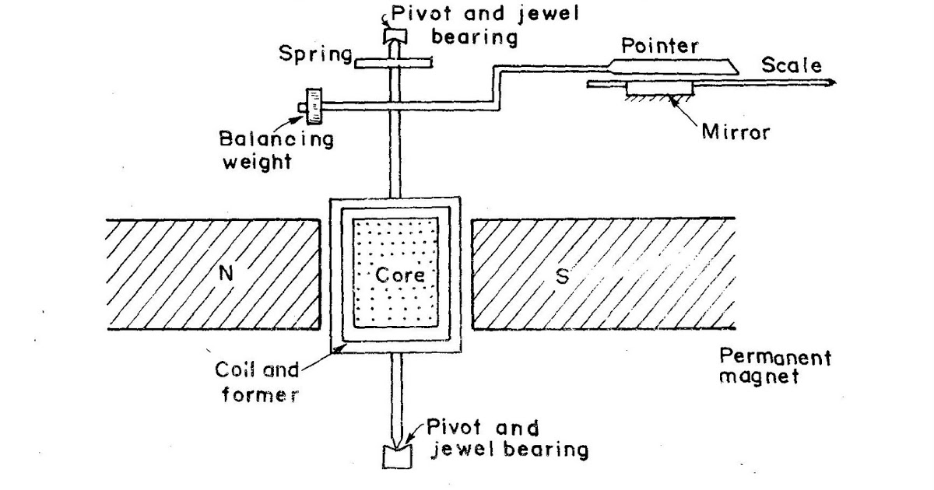
Construction of PMMC Instrument

Slide 49
The moving coil and permanent magnet are the main part of the PMMC instrument.
Moving Coil – The coil is the current carrying part of the instruments which is freely moved between the stationary field of the permanent magnet.
The current passes through the coil deflects it due to which the magnitude of the current or voltage is determined.
The coil is mounted on the rectangular former which is made up of aluminum.
The former increases the radial and uniform magnetic field between the air gap of the poles.

Slide 50
The coil is wound with the silk cover copper wire between the poles of a magnet.
Magnet System – The PMMC instrument using the permanent magnet for creating the stationary magnets.
The Alcomax and Alnico material are used for creating the permanent, the magnet has high field intensities.
Control – In PMMC instrument the controlling torque is because of the springs.
The springs are made up of phosphorous bronze and placed between the two jewel bearings.

Slide 51
The spring also provides the path to the lead current to flow in and out of the moving coil. The controlling torque is mainly because of the suspension of the ribbon.
Damping – The damping torque is used for keeping the movement of the coil in rest.
This damping torque is induced because of the movement of the aluminum core which is moving between the poles of the permanent magnet.
Pointer & Scale – The pointer is linked with the moving coil. The pointer notices the deflection of the coil, and the magnitude of their deviation is shown on the scale.

Slide 52
The pointer is made of the lightweight material, and hence it is easily deflected with the movement of the coil.
Torque Equation for PMMC Instrument
The deflecting torque induces because of the movement of the coil. The deflecting torque is expressed by the equation shown below.
Where
N-Number of turns of coil
B – flux density in the air gap
A– Area of the vertical and horizontal
I – current through the coil
N-m (newton meter)

Slide 53
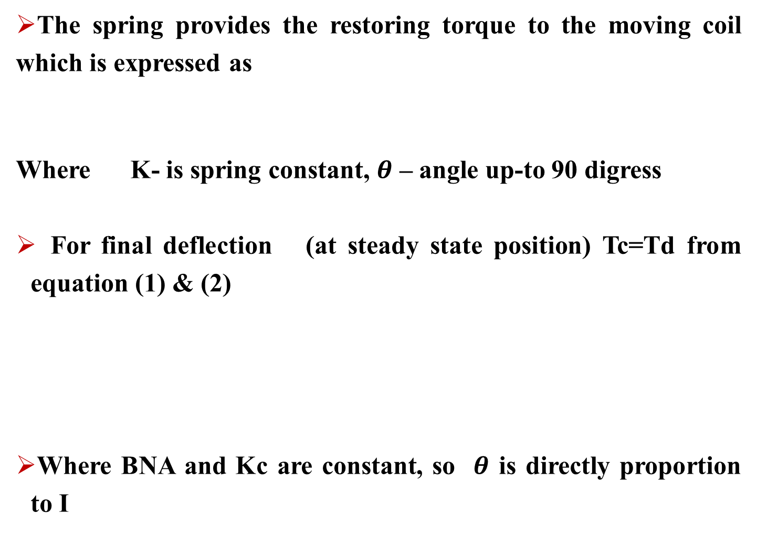
The spring provides the restoring torque to the moving coil which is expressed as
Where K- is spring constant, $θ$ – angle up-to 90 digress
For final deflection (at steady state position) Tc=Td from equation (1) & (2)
Where BNA and Kc are constant, so $θ$ is directly proportion to I

Slide 54
The above equation shows that the deflection torque is directly proportional to the current passing through the coil.
PMMC is similar to a permanent magnet DC motors with a limited speed. It use only for measuring DC ( DC Current and voltage).
Advantages of PMMC Instruments
The following are the advantages of the PMMC Instruments.
The scale of the PMMC instruments is correctly divided.
The power consumption of the devices is very less.
The PMMC instruments have high accuracy because of the high torque weight ratio.

Slide 55
The single device measures the different range of voltage and current. This can be done by the use of multipliers and shunts.
The PMMC instruments use shelf shielding magnet which is useful for the aerospace applications.
Disadvantages of PMMC Instruments:
The following are the disadvantages of the PMMC instruments.
The PMMC instruments are only used for the direct current. The alternating current varies with the time. The rapid variation of the current varies the torque of the coil. But the pointer can not follow the fast reversal and the deflection of the torque. Thus, it cannot use for AC.

Slide 56
The cost of the PPMC instruments is much higher as compared to the moving coil instruments.
Extension Range of PMMC:
Measuring the higher values of DC currents and voltage by small circuit modifications in the existing instruments is called extension of range of an instrument.
DC Ammeter: To increase the range of ammeter, a low value of resistance must be connected in parallel with the meter in order to measure large current.

Slide 57
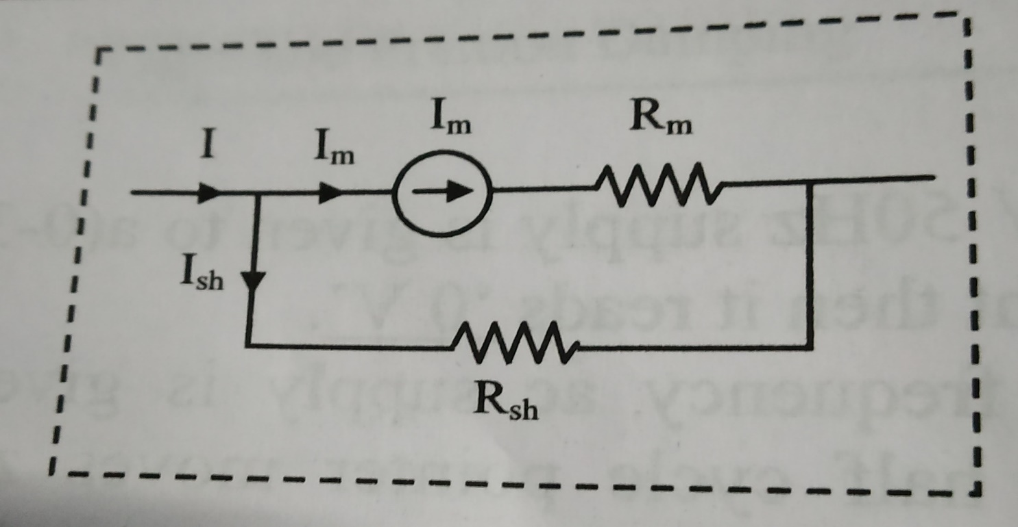

The greater part of the current in the main circuit is then diverted around the coil through the shunt.
The shunt current $I_{sh}$ can be calculated from the circuit is

Slide 58
The voltage drop across the shunt branch and instrument are same
Substitute value from equation (1) in equation (2) is

Slide 59
Where is called multiplication factor , the internal resistance value is very small.
Problem 1: A (0-1 mA) ammeter has it internal resistance 10 ohm. It’s range is to be extended to 100 A. Then the value of shunt resistance required is

Slide 60
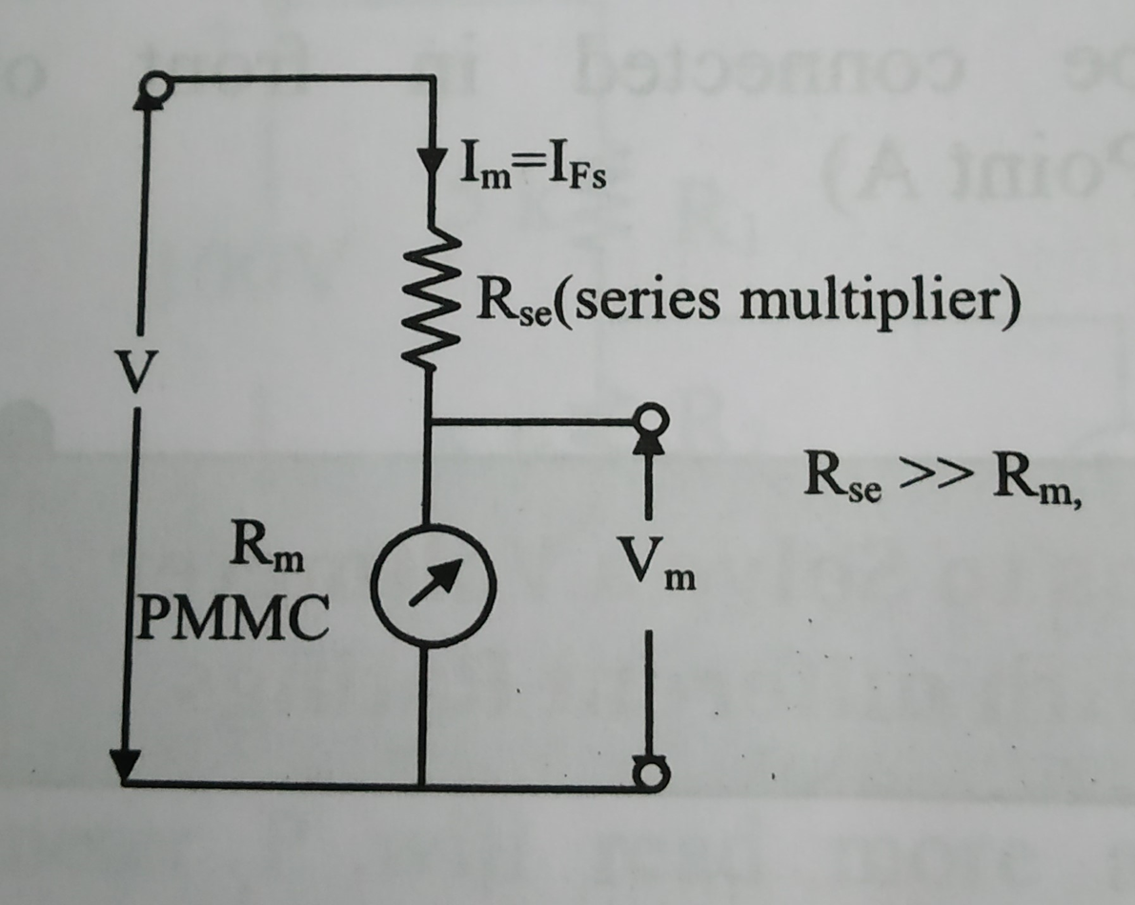
DC Voltmeter: To increase the range of voltmeter, a high value of resistance must be connected in series with the meter in order to measure large voltage.

Slide 61
The voltage across instrument is given by
calculate value from above equation is

Slide 62
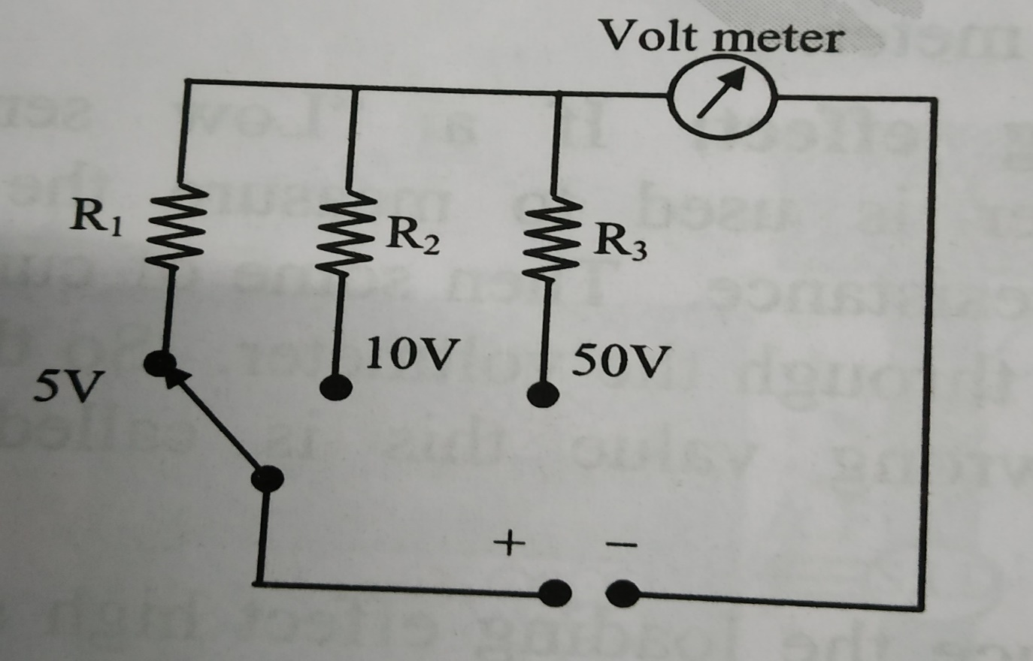

Problem 2: A multi range voltmeter is shown in figure with full scale deflection current of 50 $μA$ and meter resistance of 1000 ohm. What are the resistance $R_{1}$, $R_{2}$ and $R_{3}$ respectively?

Slide 63
Permanent Magnet Moving Iron (MI) Instrument
The instrument in which the moving iron is used for measuring the flow of current or voltage is known as the moving iron instrument.
One of the most accurate instrument used for both AC and DC measurement is moving iron (MI) instrument. There are two types of moving iron instrument.
Attraction type
Repulsion type

Slide 64
Attraction Type Moving Iron (MI) Instrument
It works on the principle that the iron place near the magnet attracts towards it. The force of attraction depends on the strength of the magnet field.
The magnetic field induces by the electromagnet whose strength depends on the magnitude of the current passes through it.
The instrument in which the iron plate attracts from the weaker field towards the stronger field such type of instrument is known as the attraction type instrument.

Slide 65
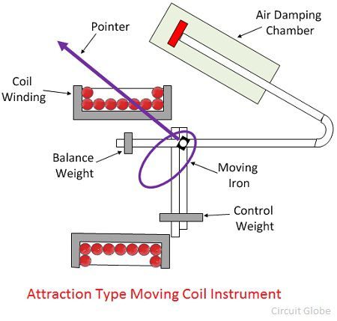

Slide 66
The current to be measured is passed through the fixed coil. As the current is flow through the fixed coil, a magnetic field is produced.
By magnetic induction the moving iron gets magnetized. The north pole of moving coil is attracted by the south pole of fixed coil. Thus the deflecting force is produced due to force of attraction.
Since the moving iron is attached with the spindle, the spindle rotates and the pointer moves over the calibrated scale. But the force of attraction depends on the current flowing through the coil.

Slide 67
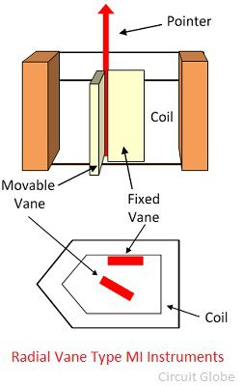
Repulsion Type Moving Iron (MI) Instrument
The repulsion type instrument has two vanes or iron plates. One is fixed, and the other one is movable. The vanes become magnetized when the current passes through the stationary coil and the force of repulsion occur between them.

Slide 68
When the current flows through the coil, a magnetic field is produced by it. So both fixed iron and moving iron are magnetized with the same polarity, since they are kept in the same magnetic field.
Similar poles of fixed and moving iron get repelled. Thus the deflecting torque is produced due to magnetic repulsion.
Since moving iron is attached to spindle, the spindle will move. So that pointer moves over the calibrated scale.
Damping: Air friction damping is used to reduce the oscillation.
Control: Spring control is used.

Slide 69
Torque Equation for Moving Iron (MI) Instrument
The deflecting torque is derived in transient period only i.e. in ‘dt’ seconds.

Slide 70
The electrical supplied to coil in ‘dt’ seconds is . From equation (1)
Initial energy stored in inductor or coil
Change in stored energy in ‘dt’ seconds

Slide 71
Mechanical work done in ‘dt’ seconds
The energy conservation law (2)=(3)+(4)
If is constant is directly proportional to

Slide 72
Advantages of the MI Instruments
Universal use – The MI instrument is independent of the direction of current and hence used for both AC and DC.
Less Friction Error – The friction error is very less in the moving iron instrument because their torque weight ratio is high. The torque weight ratio is high because their current carrying part is stationary and the moving parts are lighter in weight.
Cheapness – The MI instruments require less number of turns as compared to PMMC instrument. Thus, it is cheaper.
Robustness – The instrument is robust because of their simple construction. And also because their current carrying part is stationary.

Slide 73
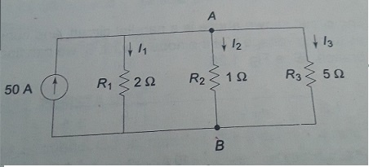
Assignment-II Questions (UNIT-I)
Explain the types of dc generators and derive the EMF equation of dc generator?
Determine the current in all resistors in the circuits shown in figures.
Explain the types of dc motor and derive the EMF equation of dc generator?

Slide 74
Assignment-II Questions (UNIT-II)
Write the voltage, current and power equations in delta connected balanced system with phasor diagrams?
Write the voltage, current and power equations in star connected balanced system with phasor diagrams?
A balanced delta connected load of per phase is connected to a balanced three supply of 400V, 50Hz supply. Determine the phase currents, line currents and power drawn by the load.

Slide 75
Assignment-II Questions (UNIT-III)
Explain three phase induction motor operation and construction details.
Describe the different type of secondary instruments.
Explain types and toque equations of the permanent magnet and moving iron (MI) instruments.

Slide 76


